Slide 1


EAT
DEEZ
Food Management System
Admin Panel
Presented by - Name : Vishal Borah.
Batch No. : 2022-8271.
Subject : P.G.C. in Java Full Stack Development for Engineers.

Slide 2
Contents:
Cover Page.
Contents.
Introduction.
Technologies Used.
Architecture of the technologies Used.
C.R.U.D Operations.
Home Page.
Add Item Page.
Update Item Page.
Delete Item Page.
View Item Page.
Spring-boot Application.
My-SQL Queries.
Angular Application.
Future Improvements.
Conclusion.
GitHub Link.
Thank You.

Slide 3
Introduction:
A food management system admin panel can be a powerful tool for restaurant owners and operators. With features such as menu management, and cost management, this system can help to streamline operations and improve efficiency.
It has the ability to manage menu items. Restaurant owners and operators can easily add or remove menu items, change prices, and update descriptions. This helps to keep menus up-to-date and ensures that customers have access to the latest offerings

Slide 4
Technologies used in this Full Stack Application Project:
Angular
My SQL
Hibernate
JPA
Spring Boot Framework

Slide 5
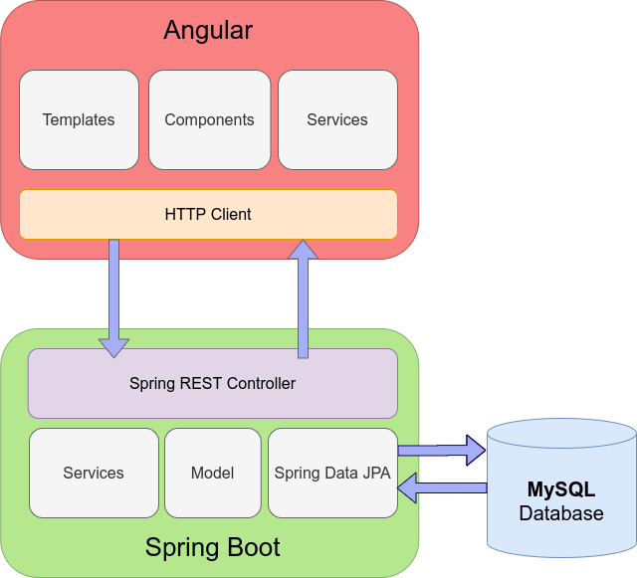
The Architecture of Angular Spring-boot & My-SQL(Database):

Slide 6
Admin Operations in the application (C.R.U.D. Operations).
CREATE
UPDATE
READ
DELETE

Slide 7
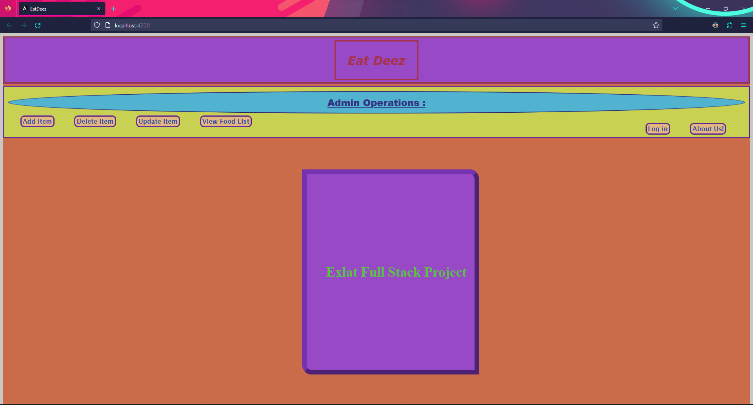
HOME Page:

Slide 8
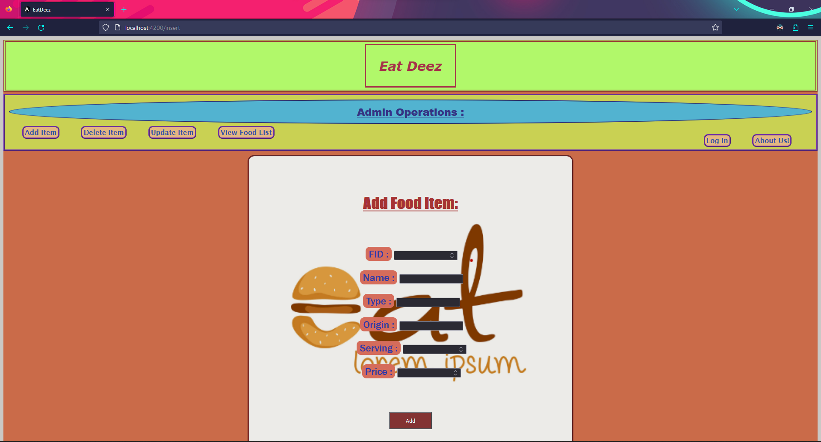
Add Item Page:

Slide 9
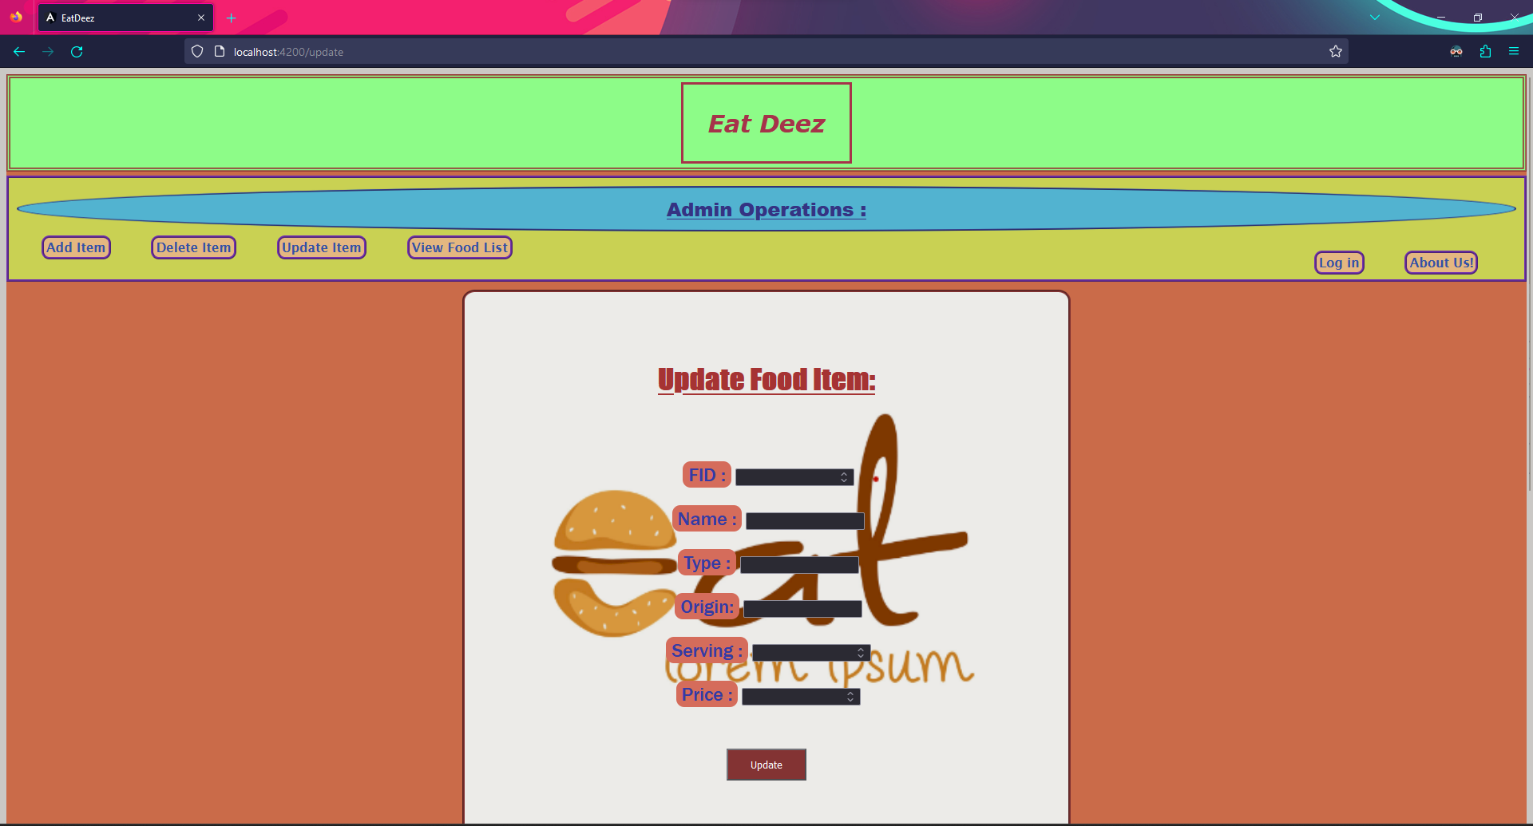
Update Item Page:

Slide 10
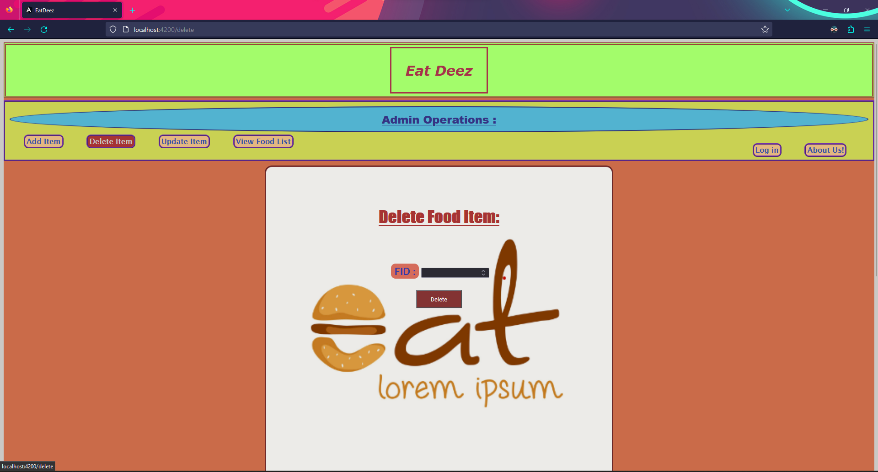
      Delete Item Page:

Slide 11
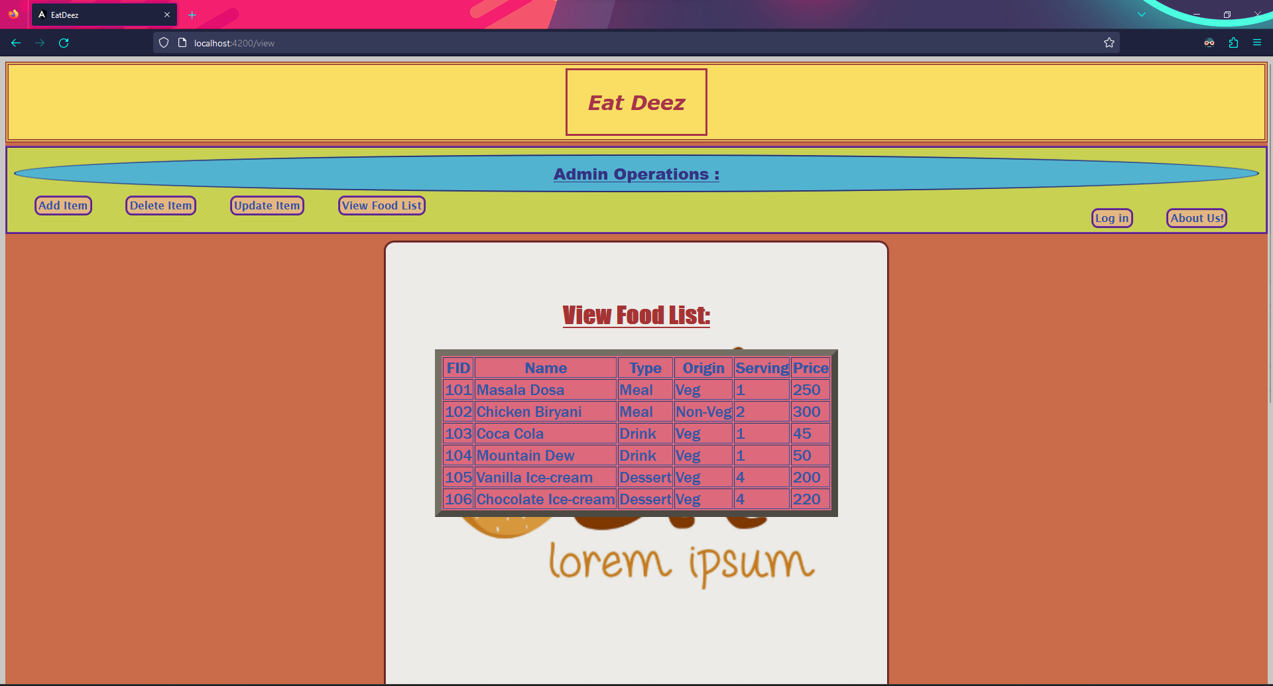
      View Item Page:

Slide 12
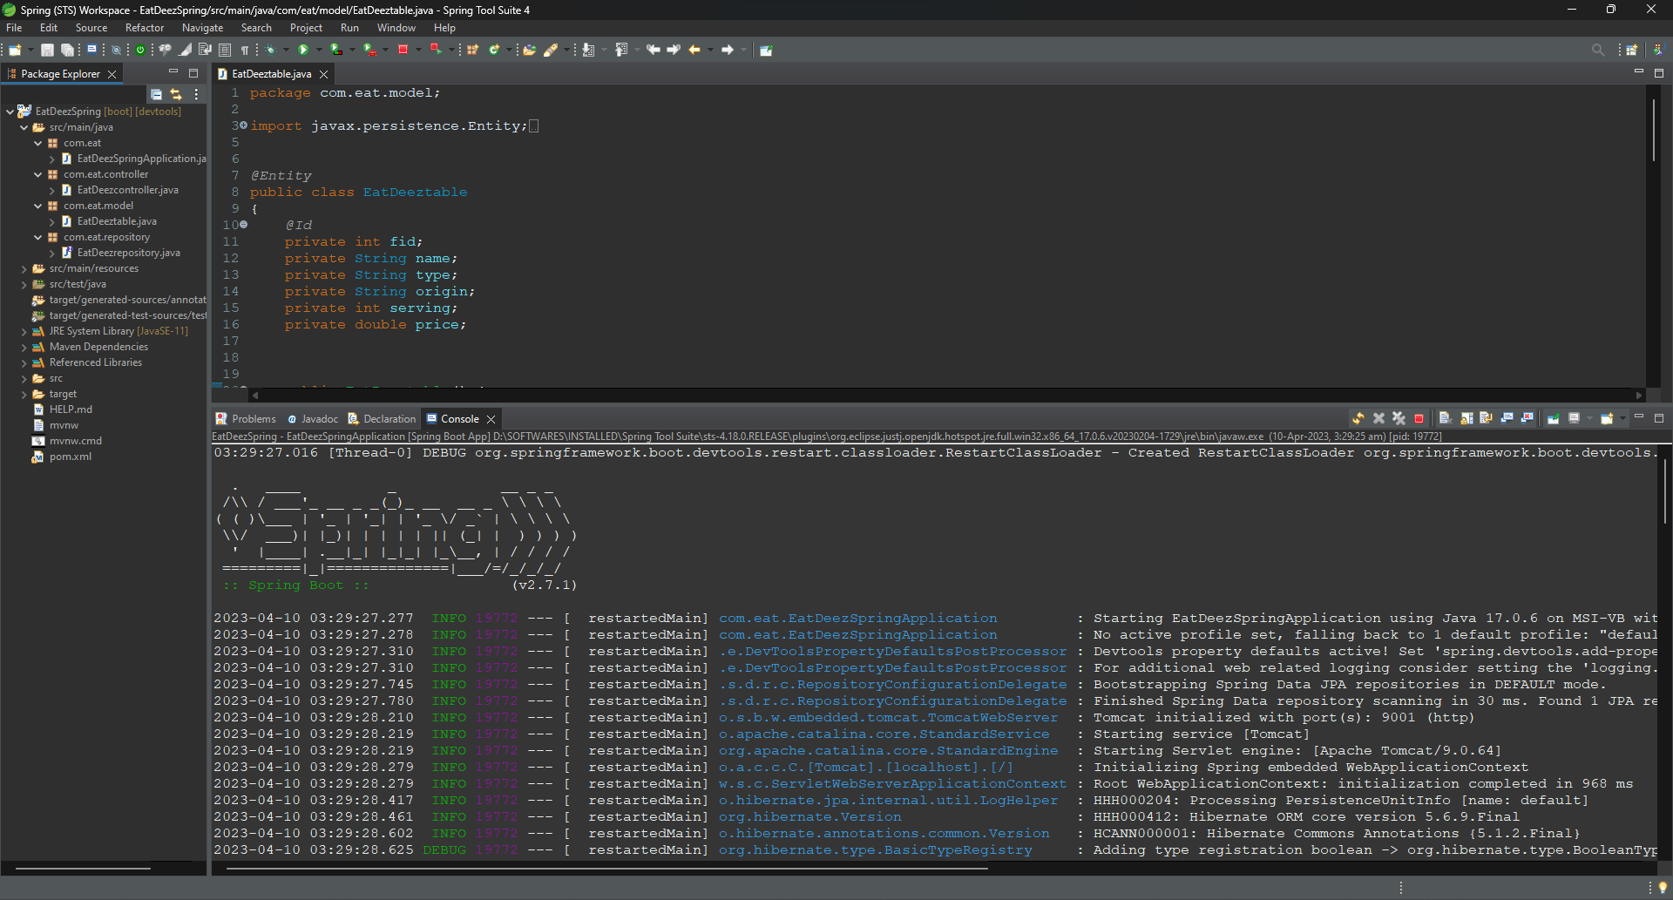
Spring-boot Application:

Slide 13
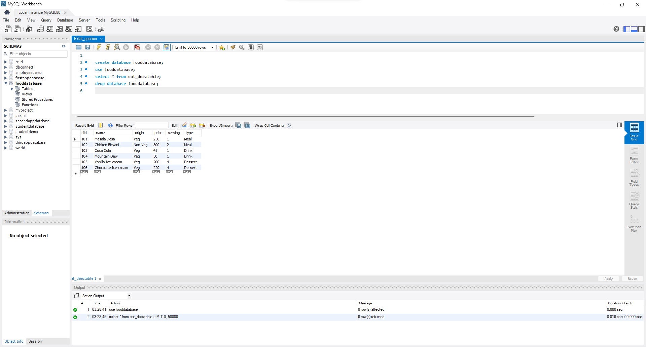
My-SQL Queries:

Slide 14
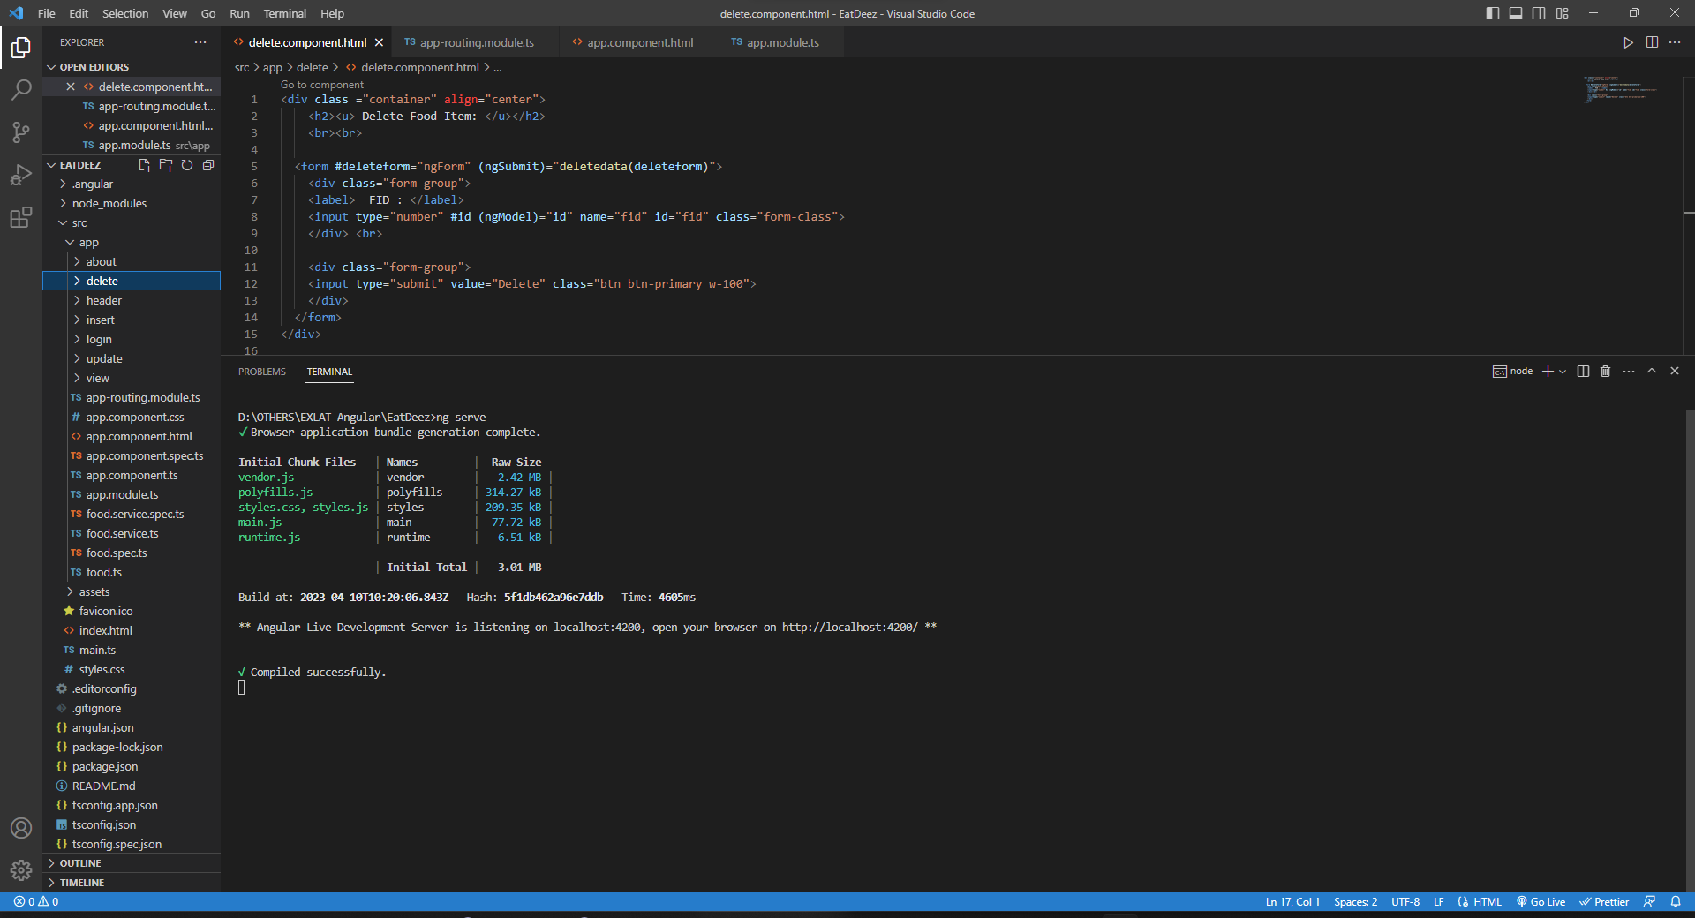
Angular Application:

Slide 15
Future Improvements:
There are various features that can be added to the current state of this application to enhance its capabilities are as follows :
A feature to make the use of the data stored in the database to figure out the popular food according to the needs of the customer for a particular demand or a moment of time.
Some more features to add the user interface for customers to make orders can also be done, etc.

Slide 16
Conclusion:
In conclusion, the system can provide valuable insights into sales performance and profitability, helping restaurant owners and operators to make data-driven decisions about their menus and offerings.
Overall, a food menu inventory management system admin panel is a must-have for any restaurant looking to improve their inventory management and offer a better customer experience.

Slide 17

GitHub Link:
Click Here :)

Slide 18

Thank You ☺

